Slide 1




BBT Bow-ties finalisation:
Guidance & troubleshooting
MARBEFES WP5 BBT workshop, 26 April 2024
Anita Franco, Mike Elliott
Anita.Franco@iecs.ltd; Mike.Elliott@iecs.ltd

Slide 2

MARBEFES WP5 BBT workshop, 26 April 2024
Aim: To discuss the finalisation of the BTs with the BBTs and troubleshooting any problem
Agenda:
Update on progress with BTs
Guidance for finalisation (also incl. standardised vocabularies)
Q&A – discussion

Slide 3
BT work – progress:
Most BBTs have delivered draft BTs by March (+TBD?)
MARBEFES WP5.1_Guidance for BBT Bow-tie finalisation.docx (11/04/24 – email + NC)
Bow-tie_CAUSES & standardised vocabularies.xlsx, Bow-tie_CONSEQUENCES standardised vocabulary.xlsx, Bow-tie_CONTROLS & standardised vocabulary.xlsx (22/04/24 – email + NC)
+
+ BTs for Aquaculture, Invasive species, Climate change
MARBEFES WP5 BT workshop, 26 April 2024

Slide 4
BT work – next steps:
BTs to be finalised by BBTs by April (Step 3)
Application of high-level scenarios using standardised lists of causes by May (Step 4)
Scoring of high-level scenarios by BBTs (downscaling) by June (Step 5)
Revision of BTs under different scenarios by September (Step 6)
(see Deliverable 5.4 – February 2024)
MARBEFES WP5 BT workshop, 26 April 2024
Notes:
Primary role of BBTs in steps 3 and 5
UCD leading step 4 (+ support in step 5)
IECS leading step 6

Slide 5
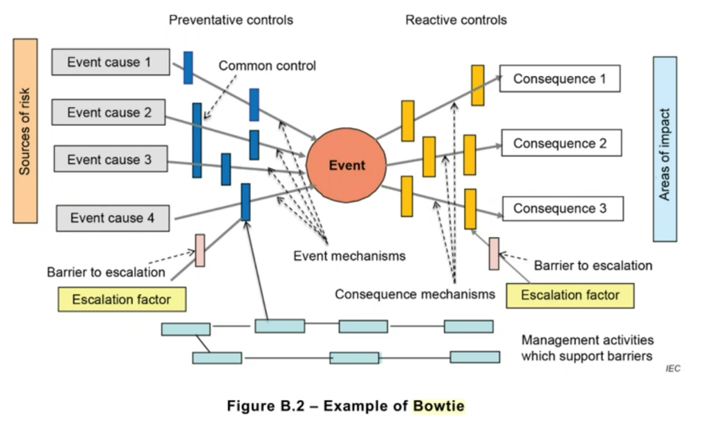
BT finalisation: Guidance & Harmonisation
Source: ECS/ISO (2019)
MARBEFES WP5 BT workshop, 26 April 2024

Slide 6
BT finalisation: Guidance & Harmonisation
In MARBEFES
BIODIVERSITY CHANGE in the BBT
Source: ECS/ISO (2019)
MARBEFES WP5 BT workshop, 26 April 2024

Slide 7
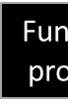
BT finalisation: Guidance & Harmonisation
D
Drivers
A
Activities
P
Pressures
S
State change
I(w)
Impact on welfare
R(m)
Response
(management measure)
Ecosystem
Structure
Functions/ processes
Services
BIODIVERSITY CHANGE in the BBT
CAUSES
CONSEQUENCES
CONTROLS
(Prevention)
CONTROLS
(Mitigation)
MARBEFES Bow-ties have lower focus on regulatory context / policy drive behind assessment of risk compared to ISO Standard BT
MARBEFES WP5 BT workshop, 26 April 2024

Slide 8
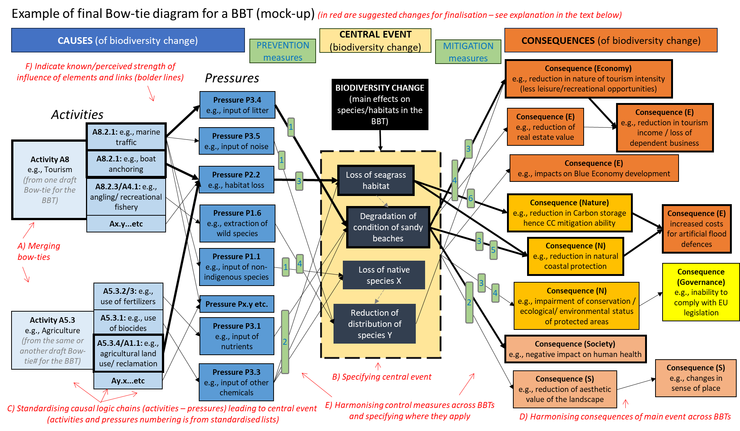
BT finalisation: Guidance & Harmonisation
MARBEFES WP5 BT workshop, 26 April 2024

Slide 9

BT finalisation: Guidance & Harmonisation
MARBEFES WP5 BT workshop, 26 April 2024
Notes:
1 (merged) BT per BBT

Slide 10
BT finalisation: Guidance & Harmonisation
MARBEFES WP5 BT workshop, 26 April 2024
Notes:
Undesirable event / to be avoided
Which habitat/species/process is affected and how?
No standardised lists
Relative spatial distribution of A/P and biodiversity components determines links
Mechanisms of change at lower level of organisation (e.g. physiological impairment) are part of the biodiversity change (albeit they may not be explicit)

Slide 11
BT finalisation: Guidance & Harmonisation
MARBEFES WP5 BT workshop, 26 April 2024
Notes:
A-P logic chains
Standardised Vocabularies (based on MSFD lists) (+ Activity-Pressure matrix)
Only causes directly leading to biodiversity change
Environmental (physico/chemical) state changes considered as causes in this BT

Slide 12
BT finalisation: Guidance & Harmonisation
MARBEFES WP5 BT workshop, 26 April 2024
Notes:
Consequences NOT of activities, but of biodiversity change
Primary & secondary consequences (e.g. nature – governance – economy)
Standardised vocabulary (based on MARBEFES BTs)

Slide 13
BT finalisation: Guidance & Harmonisation
MARBEFES WP5 BT workshop, 26 April 2024
Notes:
Prevention v Mitigation
Specific measures to specific links/elements (numbering & key)
Standardised vocabulary (based on 10 tenets of sustainable management of the environment)

Slide 14
BT finalisation: Guidance & Harmonisation
MARBEFES WP5 BT workshop, 26 April 2024

Slide 15
BT finalisation: Guidance & Harmonisation
Additional resources:
Bow-tie_CAUSES & standardised vocabularies.xlsx
Bow-tie_CONSEQUENCES standardised vocabulary.xlsx
Bow-tie_CONTROLS & standardised vocabulary.xlsx
+ Activity-Pressures matrix? (not standardised to given vocabularies)
MARBEFES WP5 BT workshop, 26 April 2024
Notes:
Standardised vocabularies organised hierarchically
Harmonisation of elements from draft BTs into standardised categories (vocabulary0

Slide 16
Questions?
MARBEFES WP4.1 EVA workshop, 9 June 2023

Slide 17
Thank you
MARBEFES WP4.1 EVA workshop, 9 June 2023

